Slide 1

PI Projection Tool Guide: Managing Research Finances
This guide explains how to access and use the PI Projection Tool for effective financial management of sponsored research projects.

Slide 2
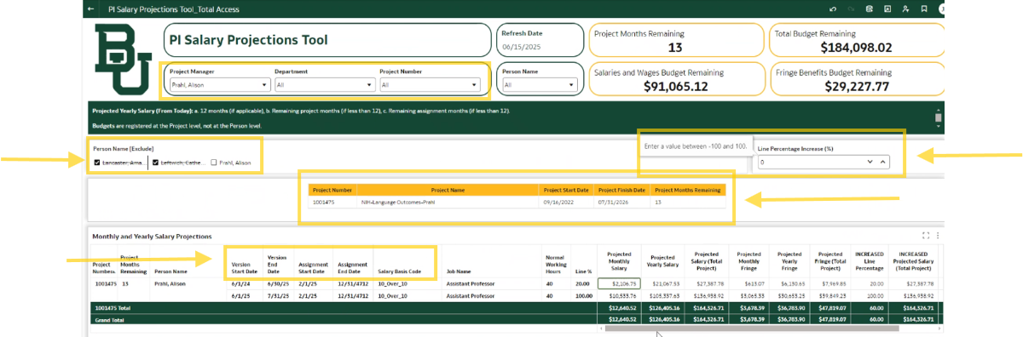
At-a-glance
Change percent effort for different cost scenarios
Modify personnel for cost analyses
Summary award data
Review parameters

Slide 3


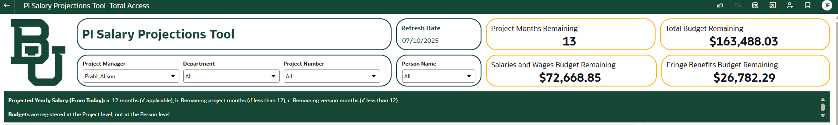

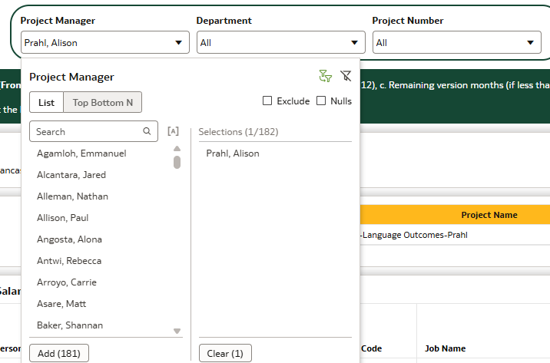

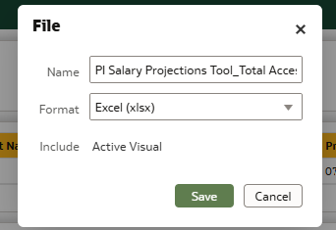

Enter site in browser
Type the tool URL in your browser's address bar.
We will also provide a link from the OVPR webpage and in the PI newsletter once the dashboard is live.
Landing Page
You'll be redirected to the dashboard home screen automatically.
Enter search parameters
Drill down into specific award data by individual, percent effort, etc.
Export as needed
Download data for further analysis and integration.

Slide 4
Understanding Projections
What It Shows
The tool projects salary for personnel paid on sponsored projects. It pulls data directly from salary and LD lines in Ignite.
This helps identify when individuals need to commit more effort to satisfy sponsor requirements or be reassigned to avoid over-expenses.
Please note: All personnel updates MUST be made in the LD module by the Department.
Data Integration
Once exported, you can easily incorporate data from other reports, such as Budget to Actuals. This includes fringe calculations for more robust projections.
Comparing and contrasting these data elements will give the most comprehensive and accurate picture of sponsored projects spending. This prevents underspending, overruns, the need for No-Cost extensions and the need for cost transfers.

Slide 5
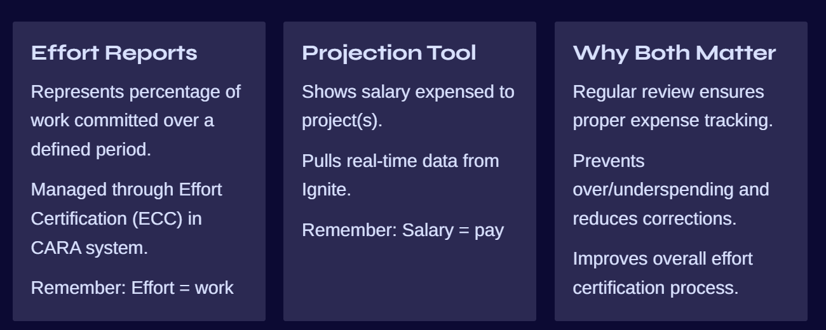
Effort vs. Salary: Important Distinctions
Is this the same as an effort report?
No, effort represents the percentage of work an individual commits over a defined period of time; this report represents the salary that is expensed to a project or projects. Effort Certification (ECC) is actionable in CARA.
Effort = work.
Salary = pay.

Slide 6
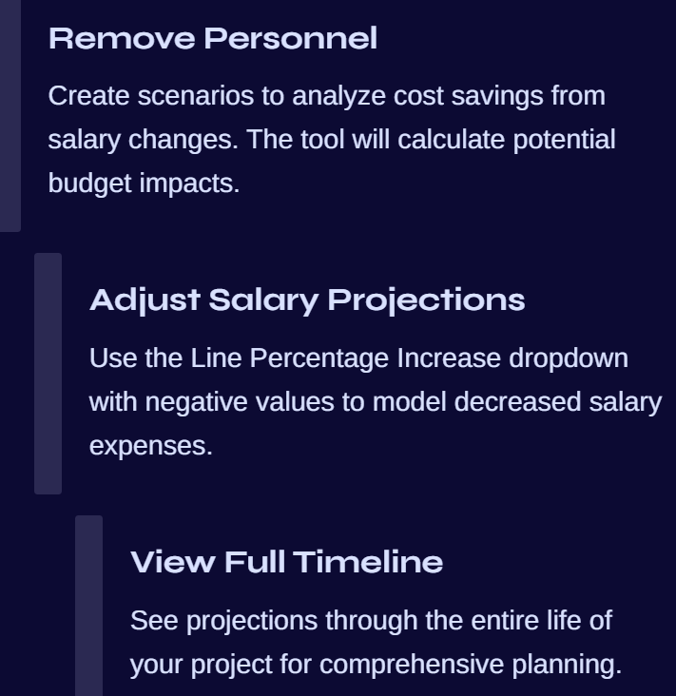
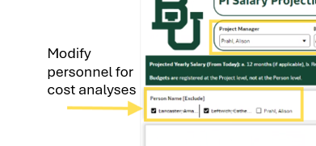
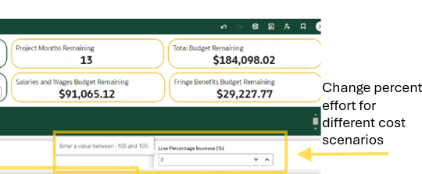
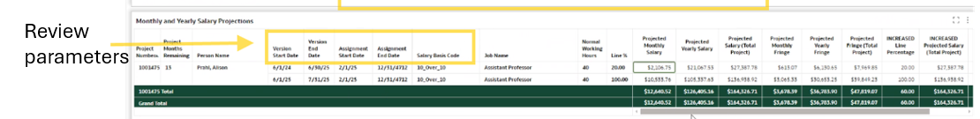
Creating Projection Scenarios

Slide 7

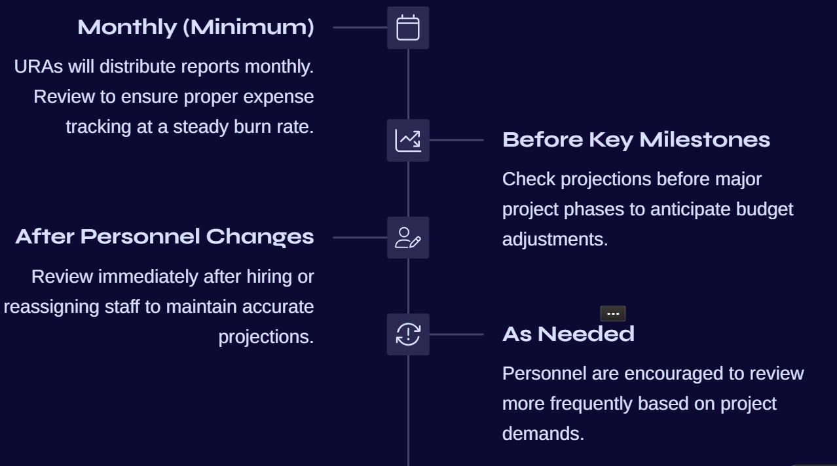
Recommended Reviewing Schedule

Slide 8

Data export & Integration
Export to Excel
Download data for custom cost analysis and budget modeling in more familiar spreadsheet format.
Compare Reports
Export Budget to Actuals to analyze salary, wages, and fringe benefits together. You will also be able to include other budget categories.
Integrate Data
Combine with other financial reports for comprehensive financial oversight.
Summary Data
Access condensed views for quick reference and high-level decision making.

Slide 9
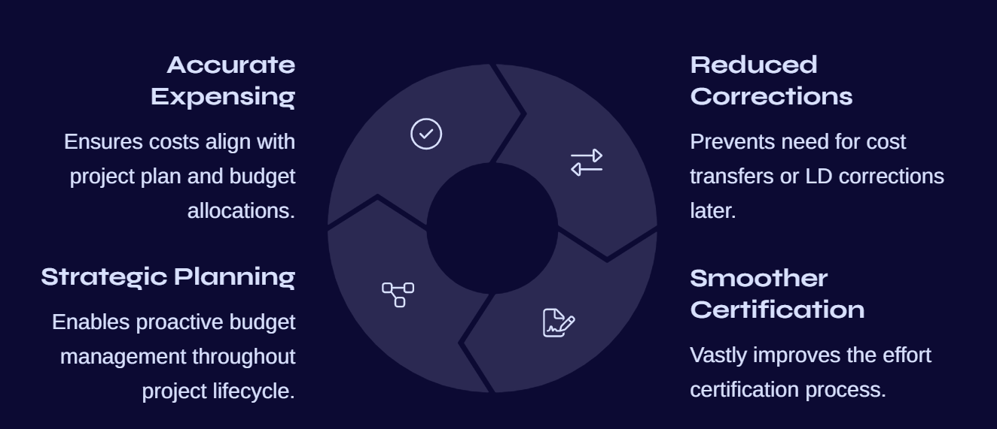
Benefits of Regular Review
Other data and systems used:
Ignite: Budget to Actuals
Ignite: Labor Distribution Module
CARA: Award terms and conditions and effort compliance
ECC: Effort Certification

