Slide 1
Using Pivot and GrantForward to Find Research Funding
Stacey L. Smith, PH.D.
Director of Research Development, OVPR
Stacey_L_Smith@baylor.edu
254-710-3252

Slide 2
LEARNING OBJECTIVES
By the end of the workshop, attendees will be able to:
Pivot-RP Database:
  Register for Pivot-RP
  Navigate and manage the Pivot home page
  Search Pivot funding via Quick Search and Advanced Search; make a Pivot Funding Opportunity active; track an opportunity; share it with others; save a search strategy; tag active and tracked records
  Claim and search profiles on Pivot
GrantForward Database:
  Register for GrantForward
  Navigate and manage the GrantForward home page
  Search GrantForward funding via Quick Search and Advanced Search
  Save searches and create alerts on GrantForward
  Claim and search profiles on GrantForward

Slide 3
ABOUT PIVOT
PIVOT (formerly COS) maintains a database of grants, fellowships, and other funding information from public and private, domestic and international sources—for science, social sciences, humanities, and community outreach funding.
Find funding opportunities and further your research using Baylor’s institutional subscription to Pivot. If you are already a COS user, log in to https://pivot.proquest.com/funding_main to claim your profile. If you're a new user, create your profile to set up your personalized funding searches

Slide 4
ABOUT PIVOT
Pivot gives researchers the ability to identify and connect with funding opportunities and with other researchers—locally and globally. It combines the most comprehensive, editorially maintained database of funding opportunities worth an estimated $33 billion with a unique database of 3 million scholar profiles—and growing

Slide 5
ACCESSING PIVOT
To create a Pivot account, go to https://pivot.proquest.com/register
Use Baylor email address.

Slide 6
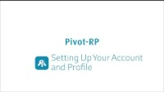
CREATING YOUR PIVOT ACCOUNT AND PROFILE
Click on the black box above or view video here: https://youtu.be/cETohWNHQAs

Slide 7
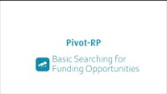
PIVOT FUNDING QUICK SEARCH
Click on the black box above or view video here: https://youtu.be/yzNvkc8nJVw

Slide 8
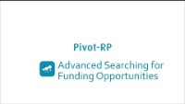
PIVOT FUNDING ADVANCED SEARCH
Click on the black box above or view video here: https://youtu.be/B58ghnkxw-Y

Slide 9
DISCOVERING PIVOT PROFILES
Click on the black box above or view video here: https://youtu.be/B58ghnkxw-Y

Slide 10
GRANTFORWARD.COM
University Development and the Baylor Libraries have purchased a subscription for Baylor faculty
Login will be found on the library homepage, Development webpage, and the Office for Research Development’s external funding searches webpage
https://www.grantforward.com/index

Slide 11

GRANTFORWARD
Click on the black box above or view video here: https://youtu.be/GZXCF1W_iZU

Slide 12
CREATING AN ACCOUNT FOR GRANTFORWARD
Go to homepage https://www.grantforward.com.
Click “sign up” at top right-hand corner.
Pick “Institutional Account.”
Put in your Baylor email, first and last name.
Create a password.
Choose Baylor from drop down file.
Click “Create my Account.”
Go to your Baylor email and follow the confirmation link.

Slide 13
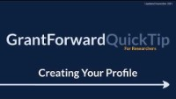
GRANTFORWARD: CREATING PROFILE
Click on the black box above or view video here: https://youtu.be/-X_wMxPzEIE

Slide 14
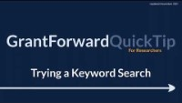
GRANTFORWARD
KEYWORD SEARCHING FOR GRANTS
Click on the black box above or view video here: https://youtu.be/I91bURC5ac0

Slide 15

GRANTFORWARD: SAVING SEARCH
Click on the black box above or view video here: https://youtu.be/tBzJh0hFy5U

Slide 16

GRANTFORWARD TAILORING YOUR GRANT RECOMMENDATIONS
Click on the black box above or view video here: https://www.youtube.com/watch?v=ZBlz2n8gPmU

Slide 17
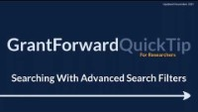
GRANTFORWARD: SEARCHING WITH ADVANCED FILTERS
Click on the black box above or view video here: https://youtu.be/DIk20kpxZ0c

Slide 18
Research Development:
Grant Writing Resources
Our office provides the following services:
Access to internal and external resources for proposal development.
https://www.baylor.edu/research/resources/index.php?id=963848
Examples:
  Grant Toolkits
  Grant Planners
  Guides for Grant Writing
  Grant Workshops
  Resources and Templates by Funding Agent (e.g., NSF, NIH, IES, HRSA, EPA)
  Successfully-Funded Grant Examples
  Templates for Letters of Support/Collaboration

